Slide 1
Getting Started with the Fabric User APIs
Ted Pattison
Principal Program Manager
Fabric CAT Team

Slide 2
Agenda
Fabric User API Fundamentals
Understanding Authentication and Authorization
Creating Workspaces and Configuring Access
Creating Semantic Models and Reports
Creating Lakehouses and Notebooks
Developing with Power BI Embedding

Slide 3

Fabric User API Design and Architecture
Fabric User API used to create and manage workspaces and workspace items
Built using principles of REST and open security standards (Open ID Connect, OAuth2)
Fabric User API accessible to any developer on any development platform
Fabric User API can be called with [user] identity or with [service principal]* identity
Public cloud endpoint accessible through base URL of https://api.fabric.microsoft.com/v1
Caller must first acquire access token for Fabric User API from Azure AD
Caller must transmit access token in all API calls using Authorization header
CAVEAT – There is no .NET SDK for the Fabric REST APIs yet – that will come in 2024 Q1
Your Application
Fabric User APIs
access token
JSON Result
HTTP Response: 200 OK

Slide 4
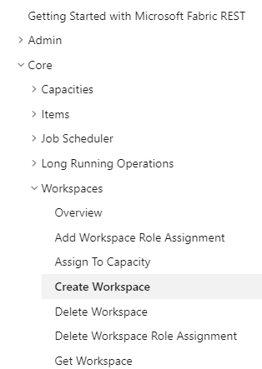
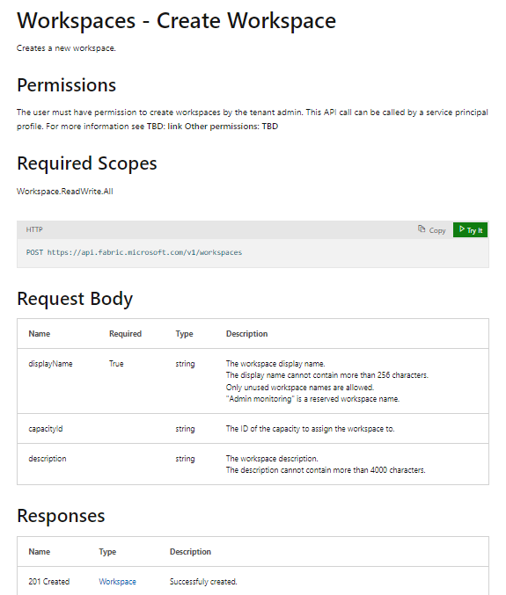
RTFM! = Read The Fabric Documentation
Fabric REST APIs documentation available online is essential developer resource
https://learn.microsoft.com/rest/api/fabric

Slide 5





Developing Multi-tenant Applications in Fabric
Multi-tenant application is responsible for creating and managing customer tenants
Customer tenant created using one or more Fabric workspaces
Developer uses Fabric User APIs to create and configure workspace items
Workspace items include lakehouses, notebooks, semantic models and reports
Fabric Multi-tenant Environment
Azure AD Tenant Owned by ISV
Customer 01 Tenant Workspace
lakehouse
notebook
model
report
Customer 01
17 users
Custom ISV Application
Customer 02 Tenant Workspace
lakehouse
notebook
model
report
Customer 02
85 users
Customer N Tenant
Customer N
450 users
lakehouse
notebook
model
report

Slide 6
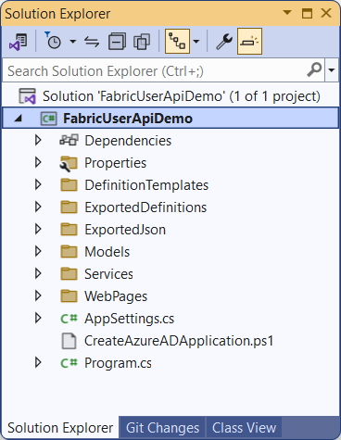
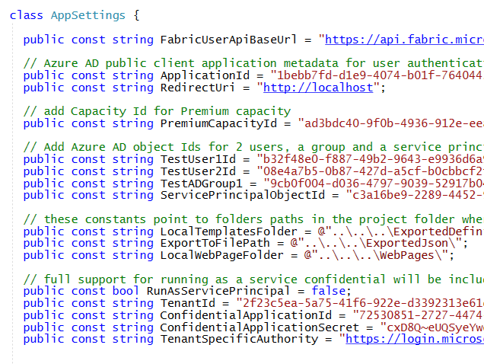
Fabric User API Demo Project
FabricUserApiDemo is developer sample which demonstrates calling Fabric User APIs
Created as simple console application created using C# and .NET 7
Can be opened and run using any version of Visual Studio 2022
You must update AppSettings.cs before you can run the project in the Visual Studio debugger

Slide 7
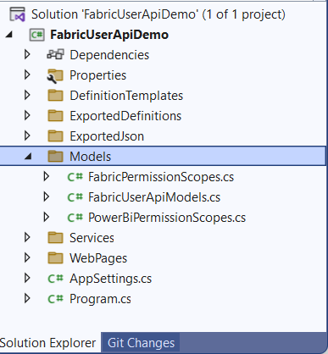
Important Classes in Models Folder
FabricUserApiModels.cs - serialization classes to convert between JSON and .NET objects
FabricPermissionScopes - delegated permission scopes for Fabric User API
PowerBiPermissionScopes - delegated permissions for Power BI REST API

Slide 8
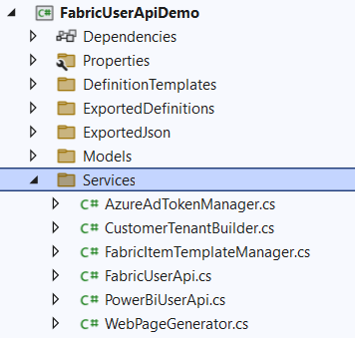
Important Classes in Services Folder
AzureAdTokenManager - used to acquire access tokens from Azure AD
FabricUserApi - used to execute HTTP requests to Fabric User API
FabricItemTemplateManager - used to assembly item definitions for Create Item API
CustomerTenantBuilder - contains logic for custom tenant provisioning flows
PowerBiUserAPi - used to execute HTTP requests to Power BI REST API
WebPageGenerator - used to generate HTML pages to demonstrate Power BI embedding

Slide 9
Agenda
Fabric User API Fundamentals
Understanding Authentication and Authorization
Creating Workspaces and Configuring Access
Creating Semantic Models and Reports
Creating Lakehouses and Notebooks
Developing with Power BI Embedding

Slide 10
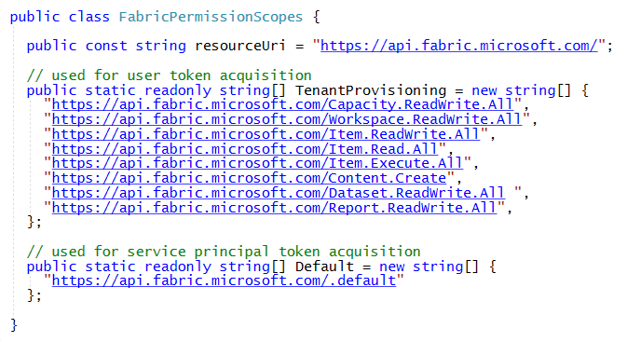
Authentication and Access Token Acquisition
Authenticating as user requires adding delegated permission scopes to access token
Required permission scopes should be passed in token acquisition request to Azure AD
Fabric API permission scopes have resource URI of https://api.fabric.microsoft.com/
Delegated permission scopes managed in FabricPermissionScopes class
Service Principal do not require delegated permissions
CAVEAT: There is not full support for service principal access in initial public preview release

Slide 11
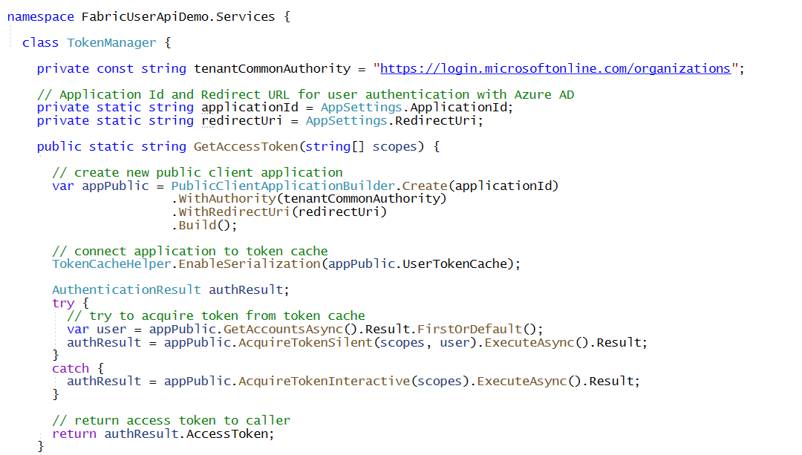
Acquiring Access Token for User using MSAL.NET
AzureAdTokenManager class provides code to authenticate user
Uses MSAL.NET (Microsoft.Identity.Client) to implement Azure AD authentication flow
Desktop and console applications can use redirect URI of http://localhost
Uses MSAL.NET support for caching access tokens and refresh tokens
Requires creating Azure AD application as public client with redirect URI of http://localhost
GetAccessToken first attempts to get token from cache before prompting user for login

Slide 12
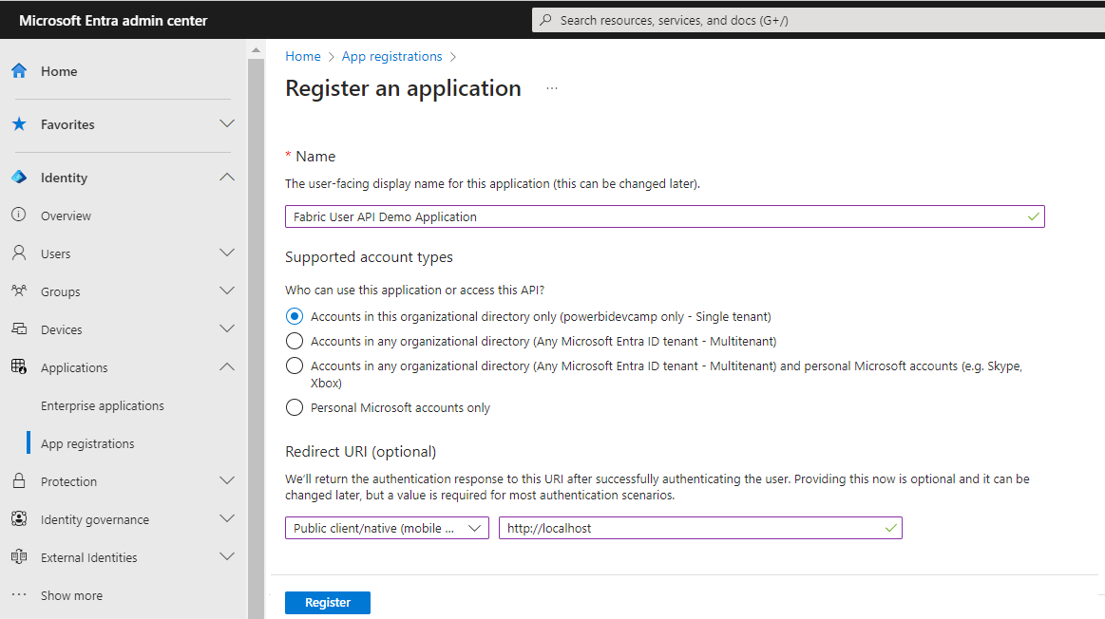
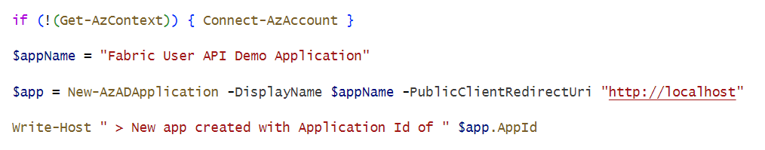
Creating New Entra Id Application
You need Entra ID application
Microsoft recently renamed Azure Active Directory to Microsoft Entra ID
Creating new application in the Entra ID portal at https://entra.microsoft.com/
Creating new Entra ID application using PowerShell

Slide 13
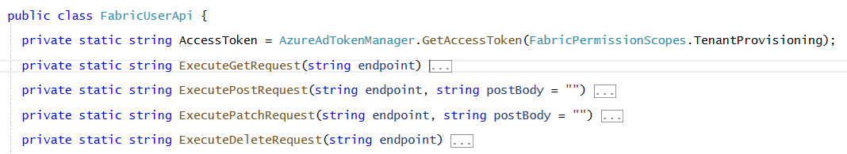
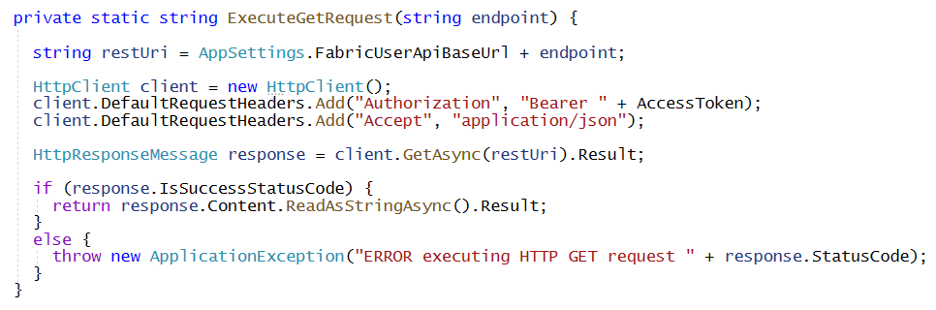
Transmitting Access Token in Fabric User API Calls
FabricUserApi class acquires access token at startup
No need to login interactively if application can retrieve access token or refresh token from cache
Methods which execute HTTP requests using HttpClient must add access token
Here's an example of ExecuteGetRequest adding Authorization header with access token

Slide 14
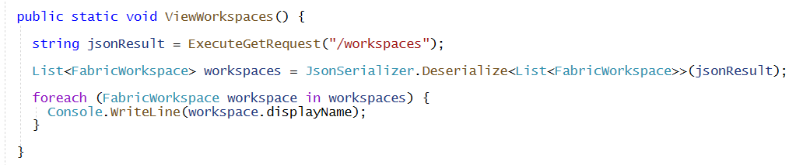
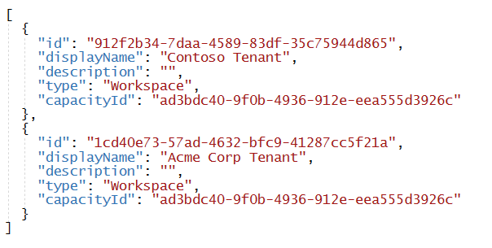
Executing Fabric API Calls with ExecuteGetRequest
Call ExecuteGetRequest by passing relative base URL to endpoint
This examples calls List Workspaces API by passing /workspaces
Calls to ExecuteGetRequest will automatically transmit access token in Authorization header
Your Application
Fabric User APIs
access token
JSON in Response Body
200 OK

Slide 15
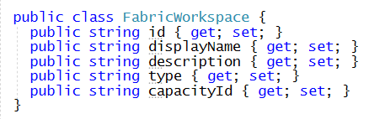
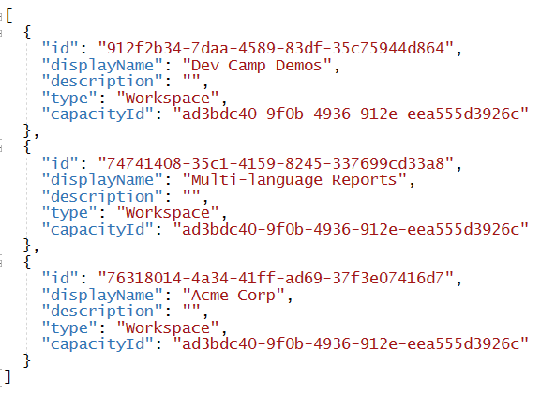
Deserializing JSON from the HTTP Response
C# serialization classes are used to convert between JSON and .NET object
Example serialization class for workspace
Use JsonSerializer and Fabric serialization class to deserialize JSON from response body
JSON in Response Body
CAUTION: Breaking changes to JSON structure across the wire scheduled for late November.
Some code in developer sample project will need to be updated.

Slide 16
Agenda
Fabric User API Fundamentals
Understanding Authentication and Authorization
Creating Workspaces and Configuring Access
Creating Semantic Models and Reports
Creating Lakehouses and Notebooks
Developing with Power BI Embedding

Slide 17
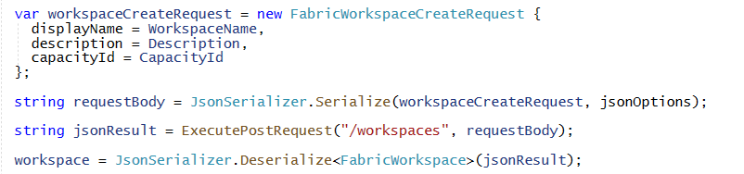


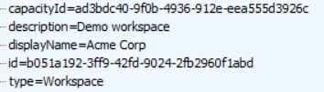
Create Workspace
Workspace created using POST operation with JSON body payload
Use JsonSerializer and Fabric serialization class to prepare JSON for request body
Successful call returns 201 CREATED and JSON response body contains Id of new workspace
Your Application
HTTP Request
Fabric User APIs
POST https://api.fabric.microsoft.com/v1/workspaces
HTTP Response
201 CREATED

Slide 18
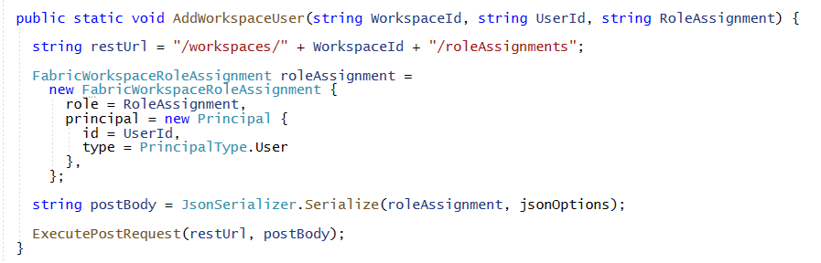

Add Workspace Role Assignment for User
Workspace role assignment added using POST operation with JSON body payload
User must be added using object Id of Azure AD user account (adding user by email not allowed)
Successful assignment of workspace role returns 200 OK
HTTP Request
POST https://api.fabric.microsoft.com/v1/workspaces/{WORKSPACE_ID}/roleAssignments
HTTP Response
200 OK

Slide 19
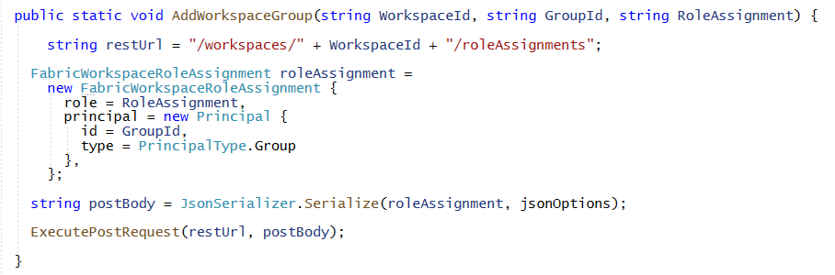
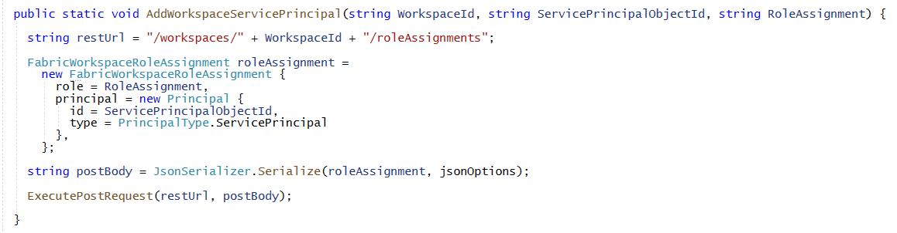
Assigning Roles to Azure AD Groups and Service Principals
Assigning workspace role to Azure AD group using object Id
Assigning workspace role to service principal using object Id

Slide 20
Agenda
Fabric User API Fundamentals
Understanding Authentication and Authorization
Creating Workspaces and Configuring Access
Creating Semantic Models and Reports
Creating Lakehouses and Notebooks
Developing with Power BI Embedding

Slide 21
Getting Away from Deployment and ALM using PBIX Files
Managing definitions for datasets and reports in Power BI has been difficult
Common to package dataset and report definitions in PBIX files created with Power BI Desktop
To developers, PBIX file is a black box that provides no ability to read or write what's inside
Developer uses Imports API to publish PBIX files which creates datasets and reports
ALM and CI/CD become problematic when managing datasets and reports using PBIX files
Fabric User API introduces much better way to create items and to manage ALM
Provides developer with full control when creating, reading or updating item definitions
Fabric User API allows developers to move past limitations of working with PBIX files
New APIs include Create Item, Get Item Definition and Update Item Definition

Slide 22
Programming with Fabric Item Definitions
Fabric items are created and updated using item definitions
Create Fabric item by calling Create Item and passing item definition
Retrieve item definition for existing Fabric item by calling Get Item Definition
Modifying existing item Fabric by calling Update Item Definition and pass item definition
Your Application
Fabric User APIs
Item
Definition
Create Item
Item
Definition
Get Item Definition
Item
Definition
Update Item Definition

Slide 23
Understanding the Abstraction of a Workspace Item
Fabric platform introduces unified Item abstraction for workspace item types
Item types are categorized by Fabric Workload
Item type Dataset has been renamed to SemanticModel
Developers use unified Create Item API together with item definition to create Fabric item
Fabric Item Types by Fabric Workload
Power BI
Data Engineering
Data Science
Data Warehouse
Real-time Analytics
SemanticModel
Lakehouse
MLExperiment
Warehouse
KQLDatabase
Report
Notebook
MLModel
MirroredWarehouse
KQLDataConnection
PaginatedReport
SparkJobDefinition
DataPipeline
KQLQueryset
Dashboard
Environment
Eventstream
Datamart

Slide 24
Fabric Item Definition Structure
To call Create Item API, you must pass displayName, type and definition
Item definition includes array of parts where each part is item-specific file
Content for parts converted to/from inline base64 format when transmitted across network
Each type of item requires unique set of parts when calling Create Item API
Creating semantic model definition requires parts for definition.pbidataset and model.bim
Create report definition requires parts for definition.pbir, report.json and optionally a theme file
displayName:
Product Sales
displayName:
Sales by Product
type:
SemanticModel
type:
Report
definition:
definition:
parts: {
}
parts: {
}
definition.pbidataset
definition.pbir
model.bim
report.json
report-theme.json

Slide 25
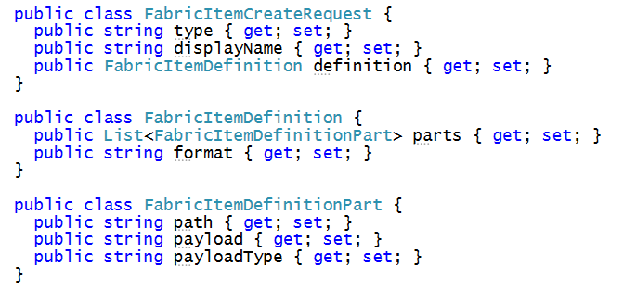
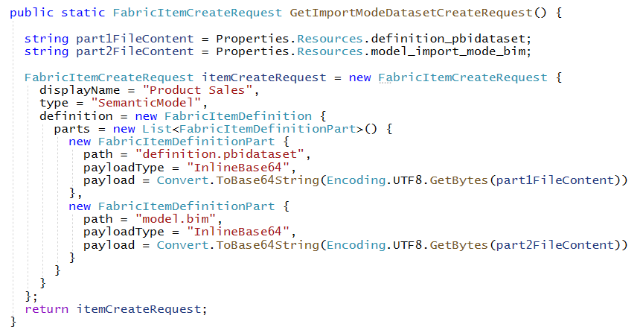
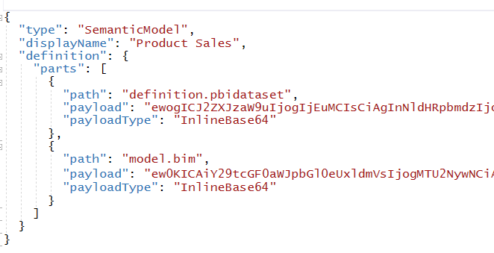
Assembling Item Definitions for Calls to CreateItem API
FabricUserApiModels.cs contains FabricItemCreateRequest serialization class
Use FabricItemCreateRequest to assemble item definition for create request

Slide 26
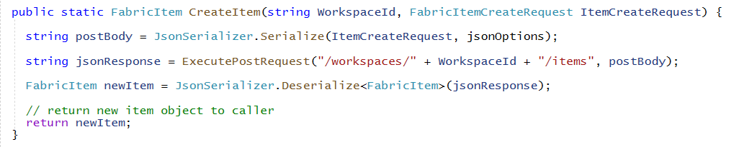
Creating Semantic Model using CreateItem
Call FabricUserApi.CreateItem passing FabricItemCreateRequest instance
CreateItem calls ExecutePostRequest to send request across network to Fabric User API
CreateItem might return 201 Created or 202 Accepted on successful call
Calling CreateItem to create a report is synchronous operation which returns 201 Created
Calling CreateItem to create semantic model is async operation which returns 202 Accepted
ExecutePostRequest must be implemented to handle both 201 response and 202 responses

Slide 27
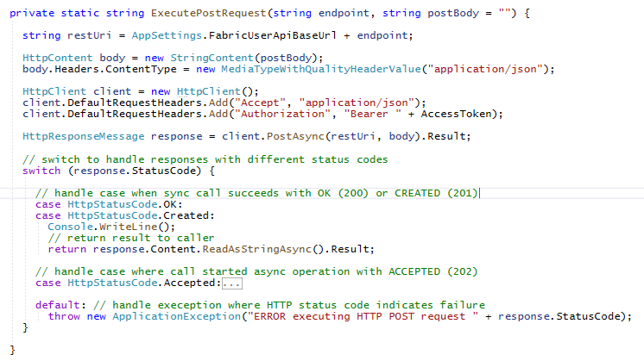
Long Running Operations – Part 1
Calls to CreateItem might return 201 Created or 202 Accepted
Calls that return 201 Created are synchronous
Calls that return 202 Accepted are asynchronous and considered to be long running operations
synchronous operation
long-running operation

Slide 28
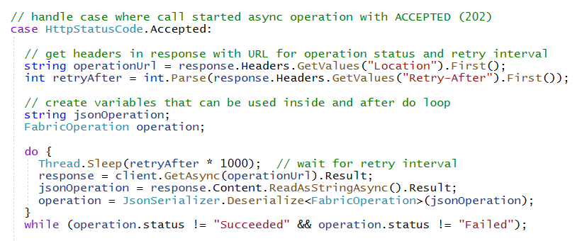
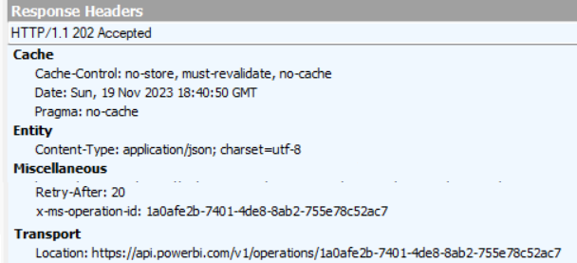
Long Running Operations – Part 2
Asynchronous calls which return 202 Accepted include two important response headers
Location response header provides URL to call Get Operation State API to get operation status
Retry-After response header returns number of seconds to wait before calling Get Operation State
Fabric User API enforces throttling to prevent caller from checking operation status too frequently
Calling too frequently for specific time window results in status code of 429 Too Many Requests
Developer should poll until response operation.status equals either "Succeeded" or "Failed"

Slide 29
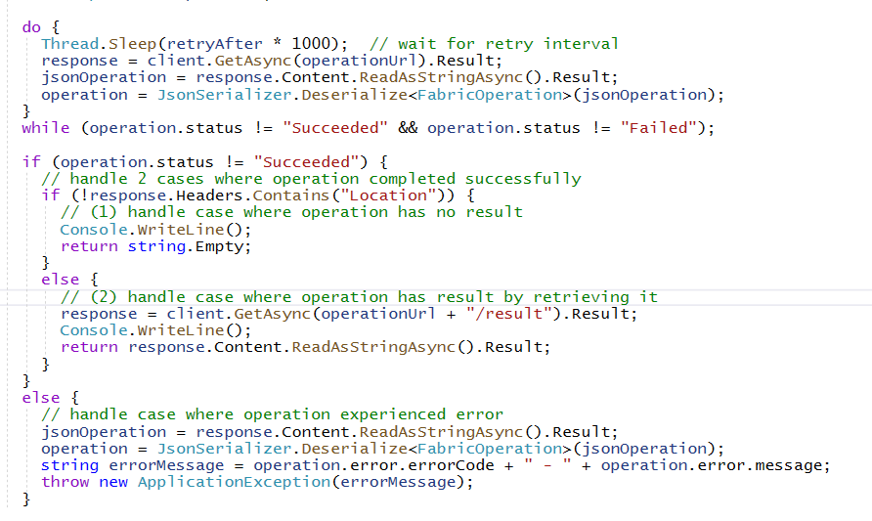
Long Running Operations – Part 3
In calls to Get Operation Status which return operation.status == "Succeeded"
If response does not include Location header, that means there is no result to return to caller
If response includes Location header, then you should call Get Operation Result to fetch result
Add /result to end of URL in Location header to call Get Operation Result
Location header absent
Location header exists
Call to Get Operation Result

Slide 30
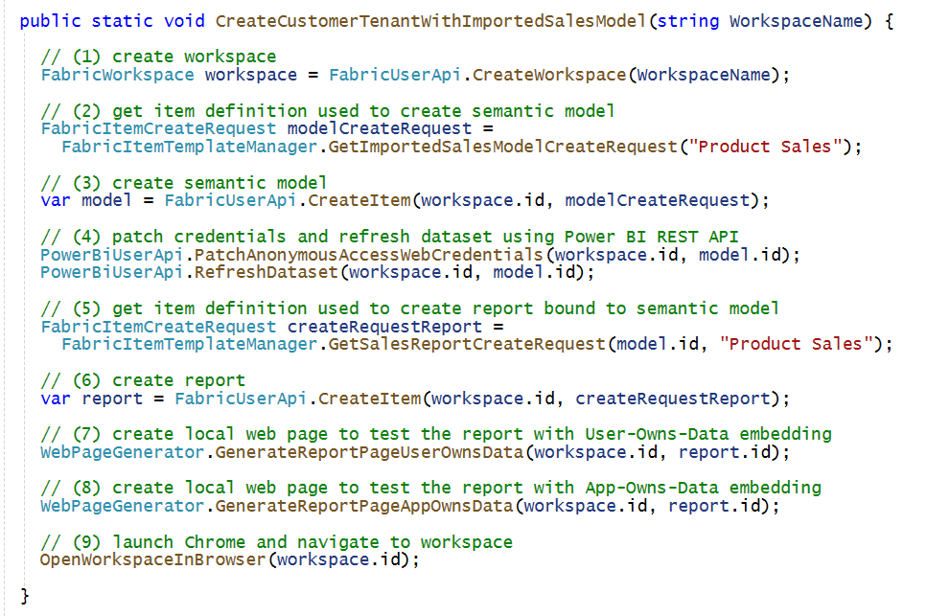
Provisioning Flow to Bind Report to Semantic Model
When you create a new report, you need to bind it to a target semantic model
When you create a new semantic model, you need to capture item Id returned from Create Item
When creating the item definition for the report, you use item Id for semantic model for binding

Slide 31
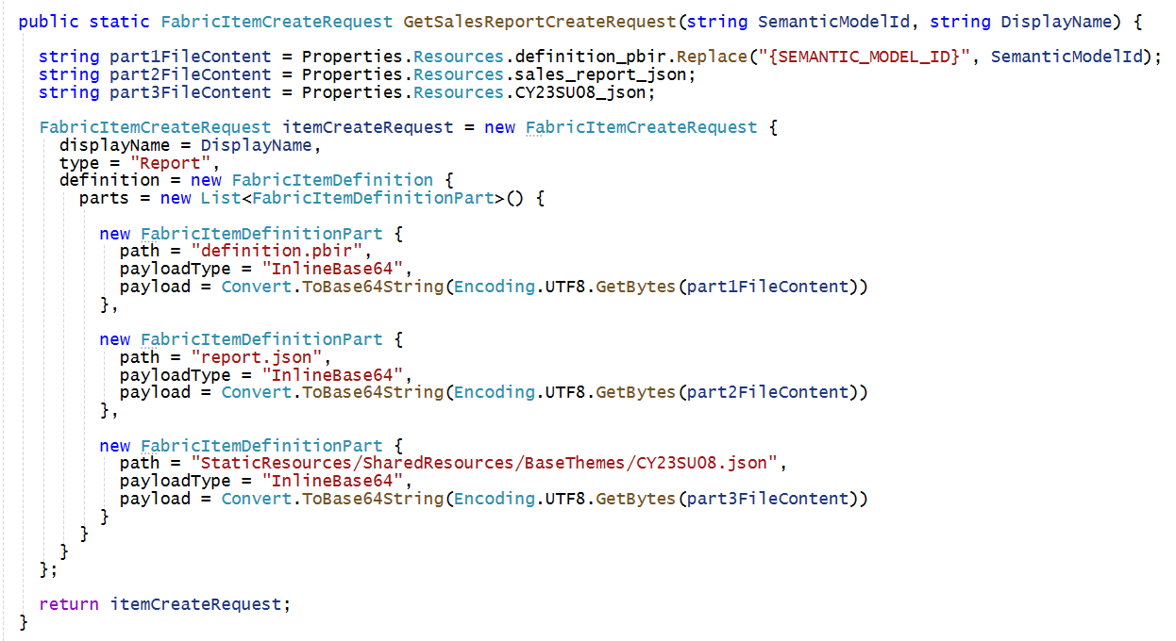
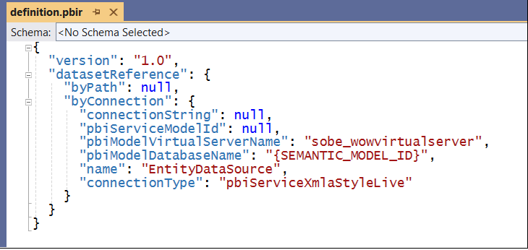
Creating Report using CreateItem API
Creating Report involves definition with the following parts
definition.pbir (this contains Id of target semantic model
report.json – This contains report layout with pages and visuals
custom-theme.json (optional) – a Power BI Desktop report theme

Slide 32
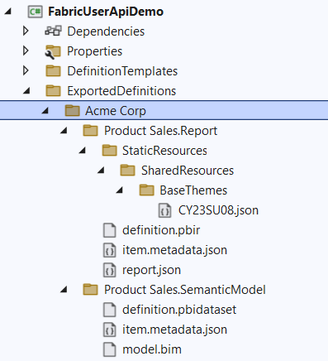
Exporting Items using Get Item Definition
Calling Get Item Definition allows you retrieve item definition for existing items
Make it possible to write content for each item definition part to local file system
Allows for reverse engineering item definition parts needed for calling Create Item API
Your Application
Item
Definition
Fabric User APIs
Get Item Definition

Slide 33
Agenda
Fabric User API Fundamentals
Understanding Authentication and Authorization
Creating Workspaces and Configuring Access
Creating Semantic Models and Reports
Creating Lakehouses and Notebooks
Developing with Power BI Embedding

Slide 34


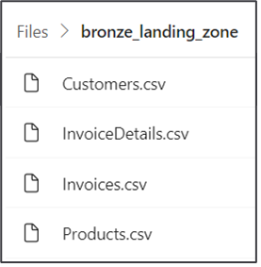
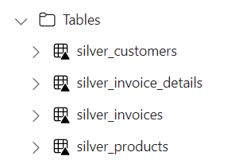
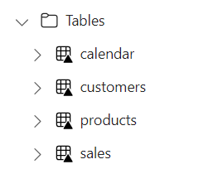

Using Spark Jobs to Create Lakehouse Tables
You can leverage Fabric support for Spark to create and populate lakehouse tables
Create lakehouse (or multiple lakehouses for greater isolation)
Create Spark Environment as workspace item for running Spark jobs
Create Notebook (or Spark Job Definition) containing ETL logic ingest data files and create tables
Execute code in notebook by running it as on-demand Spark job
Customer Tenant Workspace
Environment
Lakehouse
bronze layer
silver layer
gold layer
Custom ISV Application
notebook
Spark job
Spark job
Spark job

Slide 35
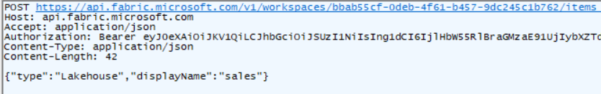
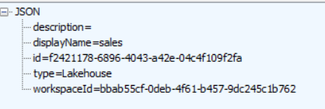
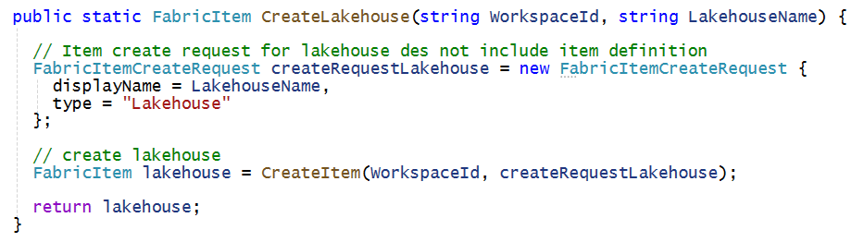
Creating Lakehouse using Create Item
Lakehouse created without item definition –only pass displayName and type
Response includes lakehouse item id which is require to create notebooks
Code used in developer sample application to create lakehouse

Slide 36
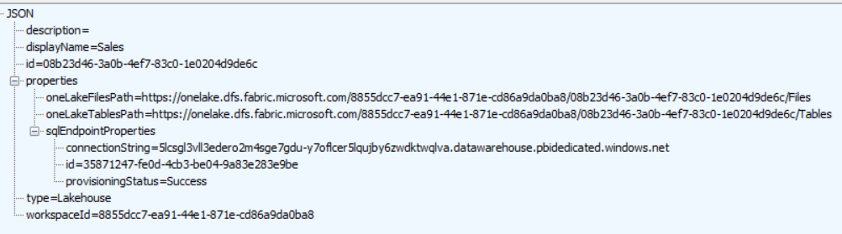
Lakehouse Properties
Retrieve lakehouse properties by executing GET request through /lakehouses endpoint
GET => /workspaces/{WORKSPACE_ID}/lakehouses/{LAKEHOUSE_ID}
Example response:

Slide 37
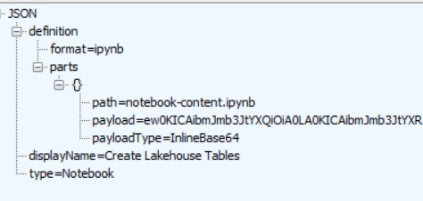
Creating a Notebook
Notebook created using
Set item definition format to ipynb
Add single part with notebook content with path of

Slide 38
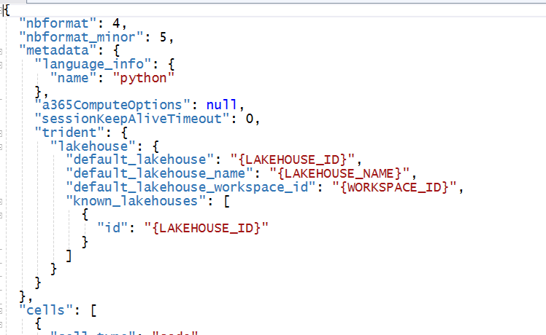
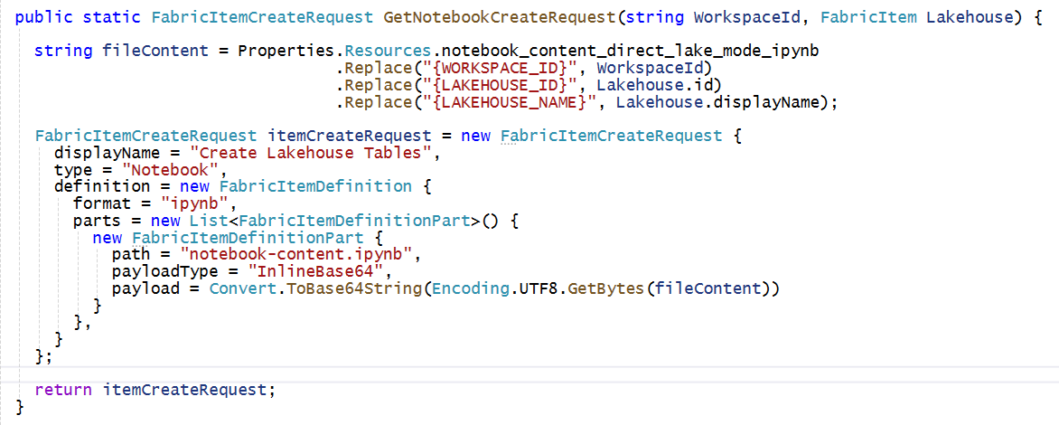
Binding Notebook to Lakehouse
Notebook item template contains placeholders
Code in developer sample

Slide 39
Job Scheduler
Fabric User API provides Job Scheduler
Run On Demand Item Job
Get Item Job Instance
Cancel Item Job Instance

Slide 40
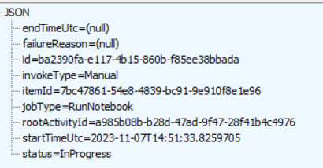
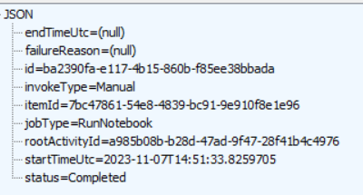
Starting On-demand Spark Job to Run Notebook
Use POST command to Job Scheduler - Run On Demand Item Job API
/workspaces/{WORKSPACE_ID}/items/{NOTEBOOK_ID}/jobs/instances?jobType=RunNotebook
Response returns Location and Retry-After headers similar to long running operation
Checking on a job status by executing GET request on URL in Location header response
Allows you to see if job has completed or still in progress
Currently uses InProgress and Completed
Should be updated to Running and Succeeded instead for consistency with long running ops

Slide 41
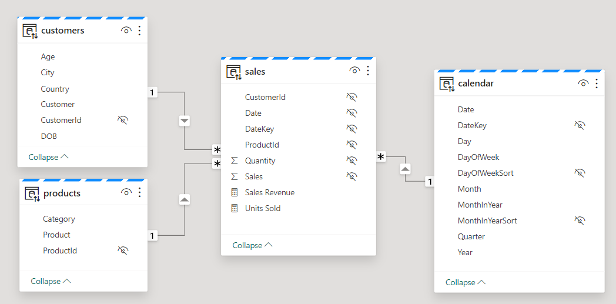
Creating Semantic Models on Lakehouse Tables
Creating semantic model on lakehouse tables uses DirectLake mode
Power BI term 'dataset' recently changed to semantic model or just model
Creating model allow you to define relationships, measures, hierarchies, etc.
Customer Tenant Workspace
Lakehouse
Semantic Model (aka Dataset)
SQL Endpoint

Slide 42
Creating and Exposing Power BI Reports
Reports can be built on top of DirectLake models
Power BI reports can provide rich interactive experience for users
Report can be made accessible to licensed users through Power BI service
Report can be made accessible to licensed users through User-Owns-Data embedding
Report cannot yet be made accessible to external users through Apps-Owns-Data embedding
Customer Tenant Workspace
Lakehouse
Semantic Model (aka Dataset)
report
Consumers
SQL Endpoint
report
Consumers
report
Consumers

Slide 43
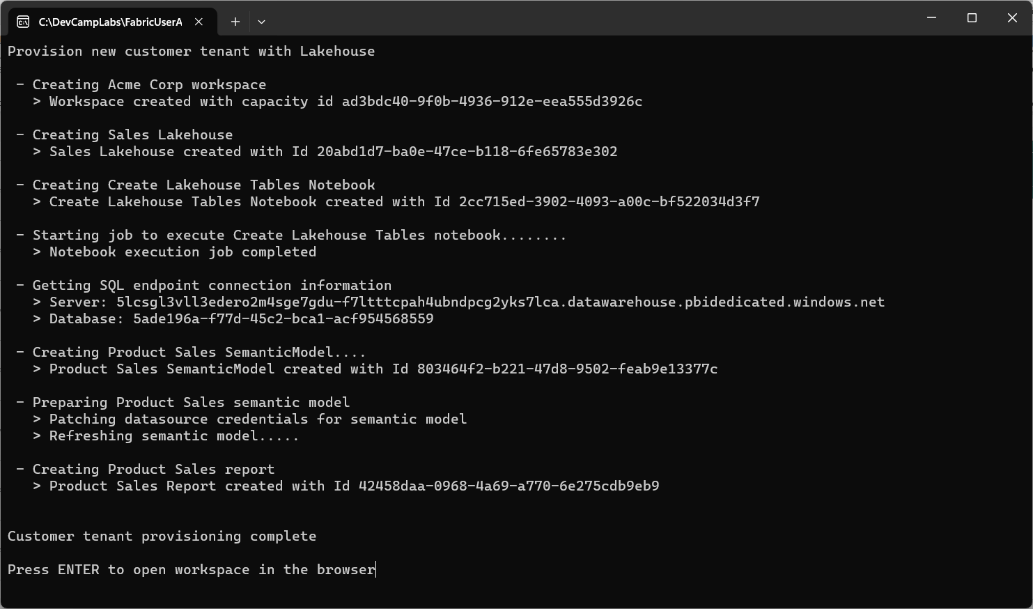

Slide 44
Agenda
Fabric User API Fundamentals
Understanding Authentication and Authorization
Creating Workspaces and Configuring Access
Creating Semantic Models and Reports
Creating Lakehouses and Notebooks
Developing with Power BI Embedding

Slide 45
Power BI Embedding
User Owns Data vs App Owns Data

Slide 46
Summary
Fabric User API Fundamentals
Understanding Authentication and Authorization
Creating Workspaces and Configuring Access
Creating Semantic Models and Reports
Creating Lakehouses and Notebooks
Developing with Power BI Embedding

Slide 47
Issues to Work Around as of Nov 1, 2023
Inconsistent support for using service principal
Workaround – Use UPN instead of SP until Fabric API SP support is complete
No ability to use DirectLake datasets with App-Owns-Data embedding
Generate Token API fails if you try to create embed token on DirectLake dataset
Hopefully, this will be addressed and fixed before the end of the year
No API to configure datasource credentials using service principal identity
Sharable cloud connections (SCC) support service principal credentials
Sharable cloud connections (SCC) can only be created manually
Missing API to automate creation of SCCs and service principal credentials

Slide 48


One Service Principal per Customer Tenant
Best strategy to scale upwards over 1000 workspaces
Best Performance because service principal is only member of a single workspace
No service principal owns datasource credentials for more than one customer tenant
Requires ongoing need to create new Azure AD applications for new tenants
Multi-tenant Environment Power BI Service
Customer 1
Multi-tenant Application
Workspace for Customer 1 Tenant
Service
Principal
Customer 2
Workspace for Customer 2 Tenant
Service
Principal
Customer 3
Workspace for Customer 3 Tenant
Service
Principal
Customer N
Service
Principal
Workspace for Customer N Tenant

Slide 49
Exposing Data to Consumers through the SQL Endpoint
Data in lakehouse tables accessible through SQL endpoint
SQL endpoint automatically created when you add tables to lakehouse
SQL endpoint of Lakehouse provides read-only access for executing queries
SQL endpoint provides data access to wide range of SQL-based applications
ISV AAD Tenant
Customer Tenant Workspace
SQL-based
Reporting Tools
Lakehouse
SQL Endpoint
SQL-based
Export Utilities
zzzz

Slide 50



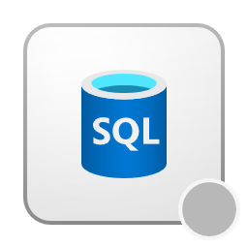
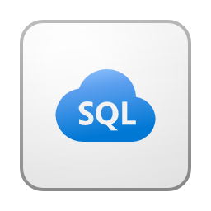
workspace
lakehouse
notebook
model
report
paginated
Spark job
Azure SQL Database Mirror
Spark Environment
Azure SQL Database

Slide 51
Implementing Medallion Architecture
Bronze
raw data imported in "as is" format
hard to secure when there are many small tables
primarily access by service principals instead of user accounts
Silver
validated, enriched version of data which is trusted for downstream workloads
employs data quality rules for validating and processing data
Historization usually applied by merging all data
Gold
provides project-specific databases
denormalized, read-optimized data model with fewer joins

